Slide 1
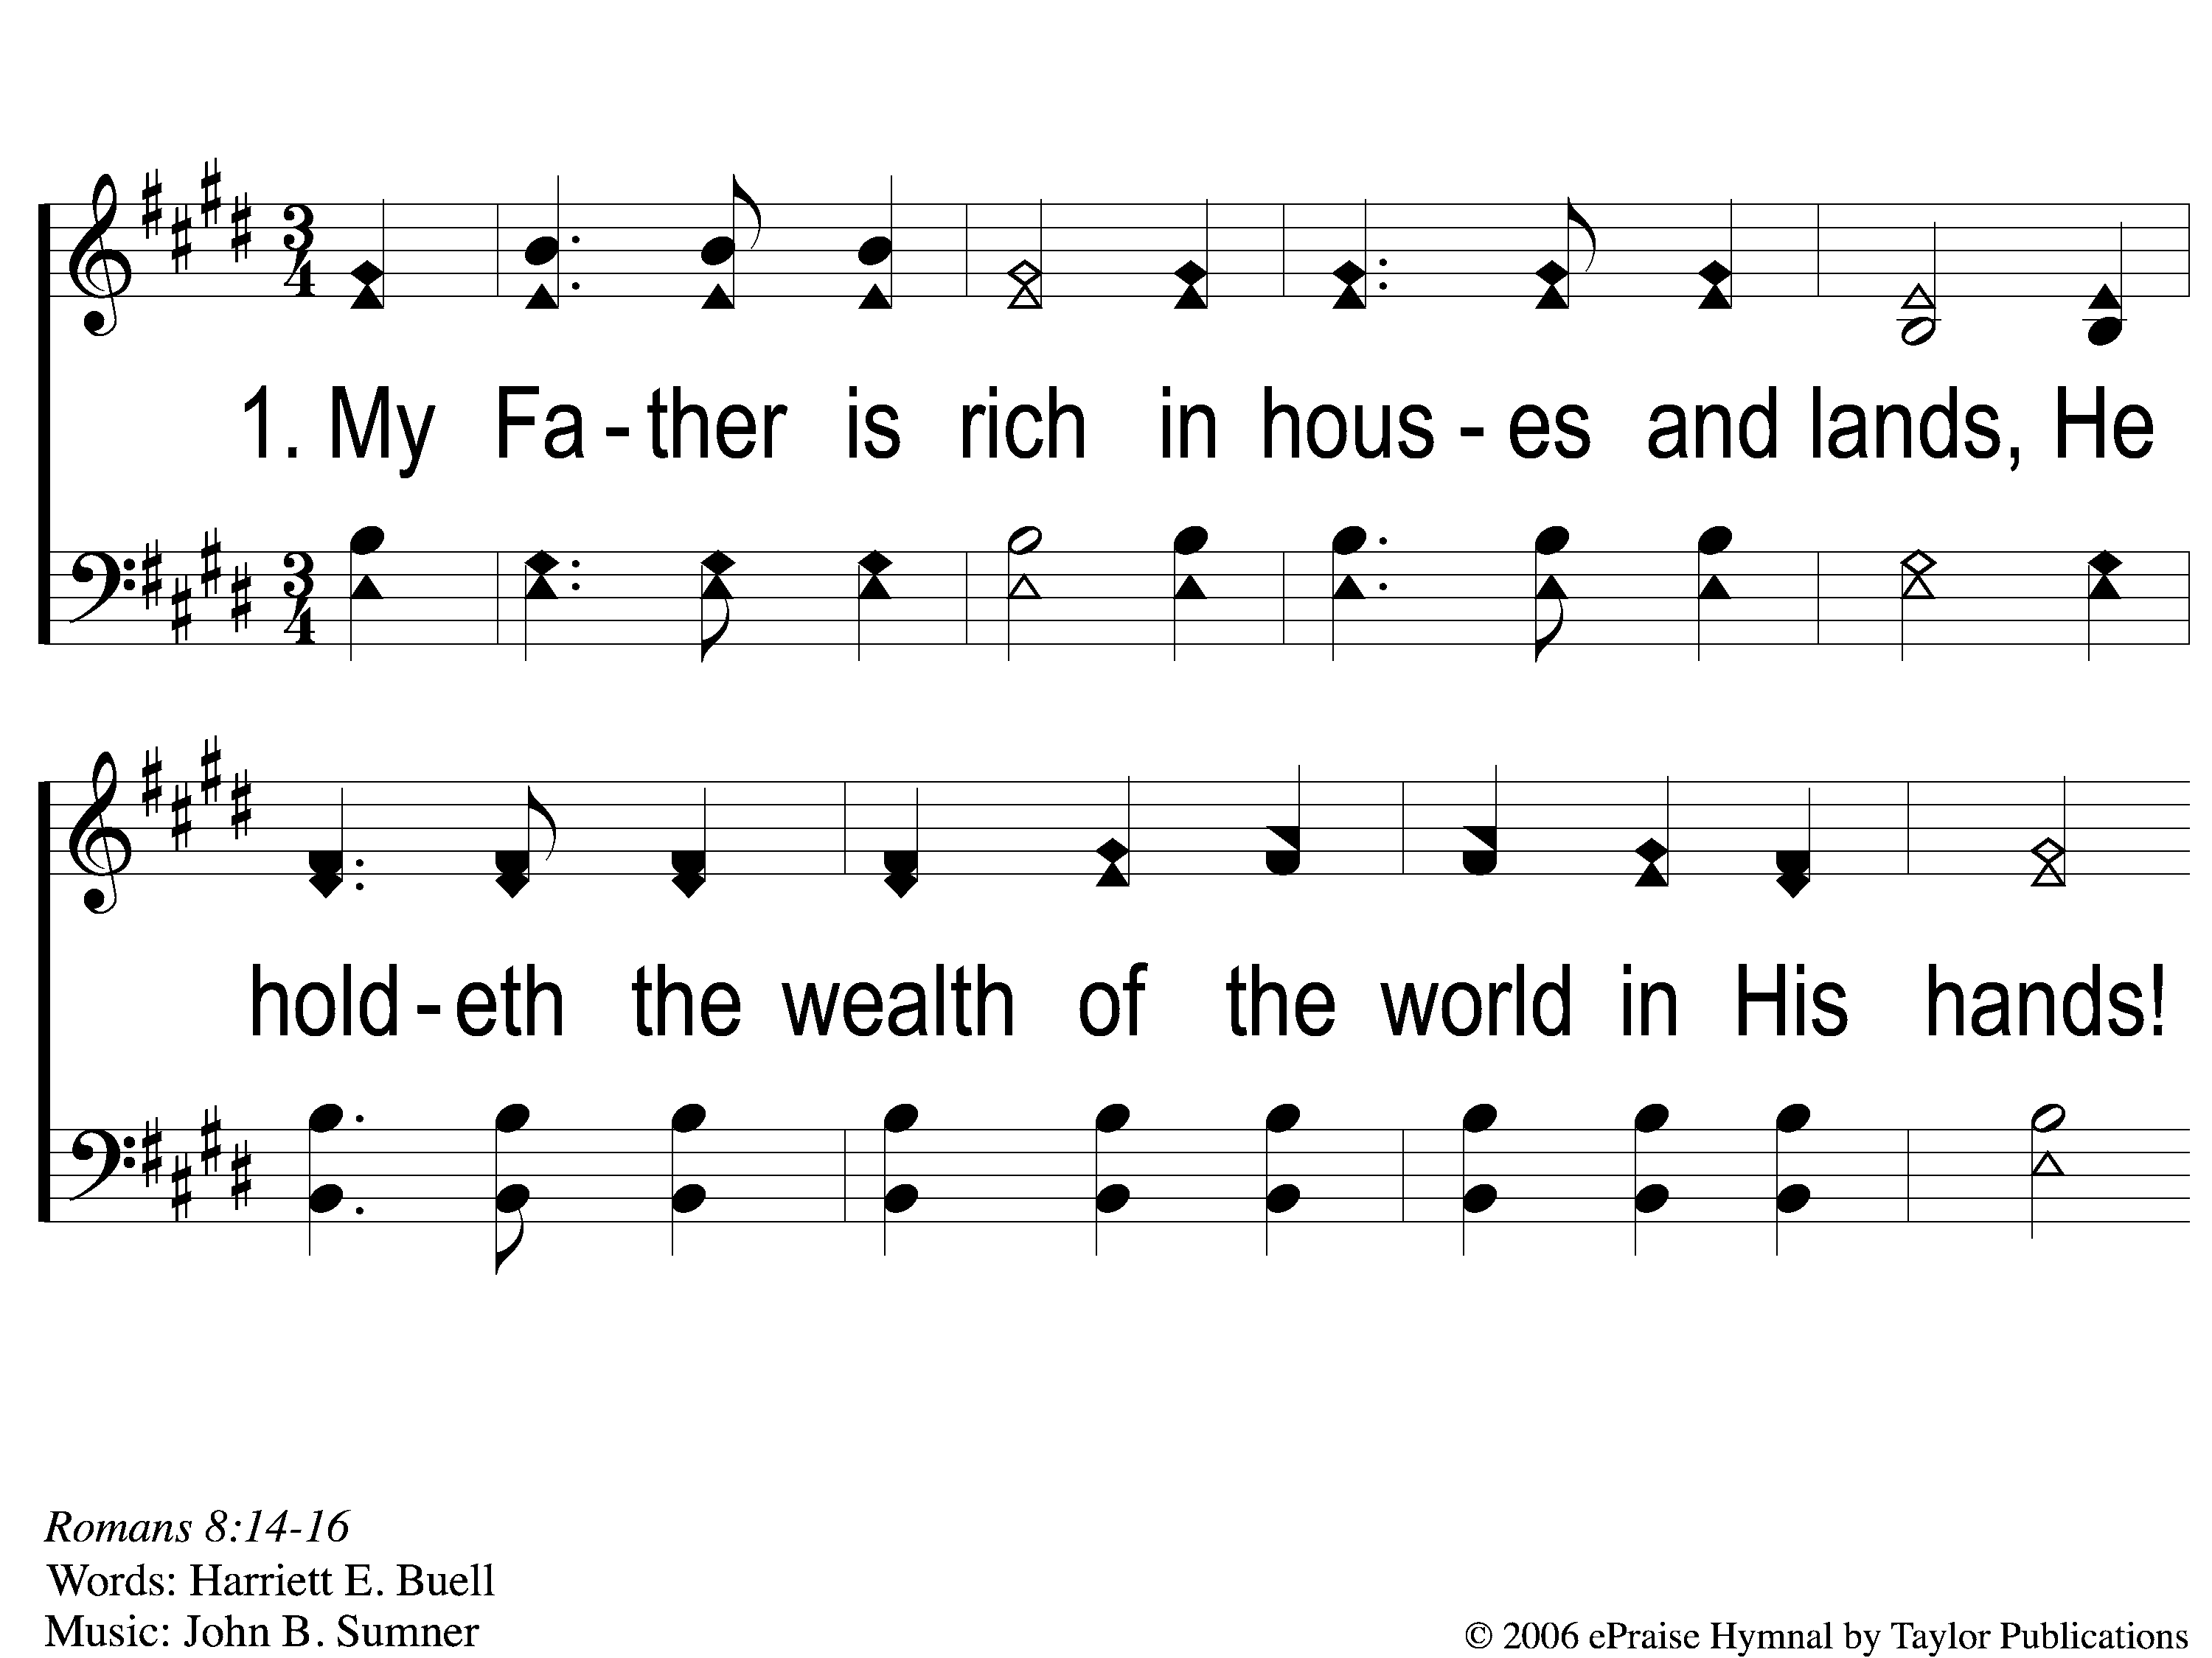
1-1 Child of the King
Child of the King
63

Slide 2
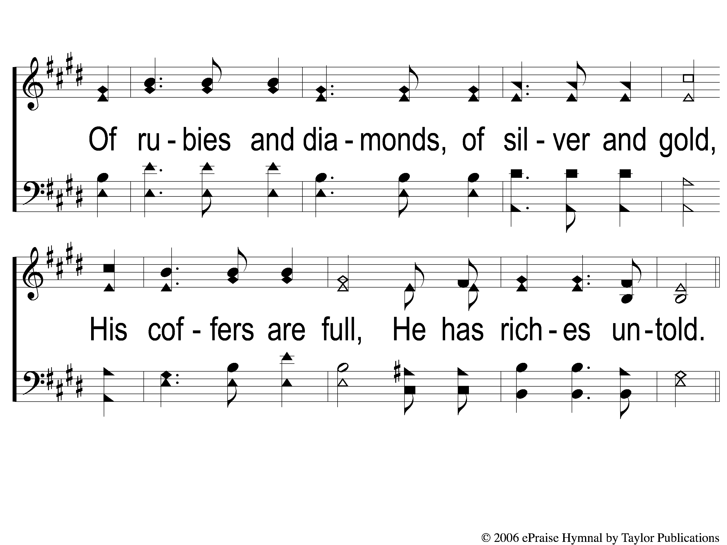
1-2 Child of the King
Child of the King
63

Slide 3
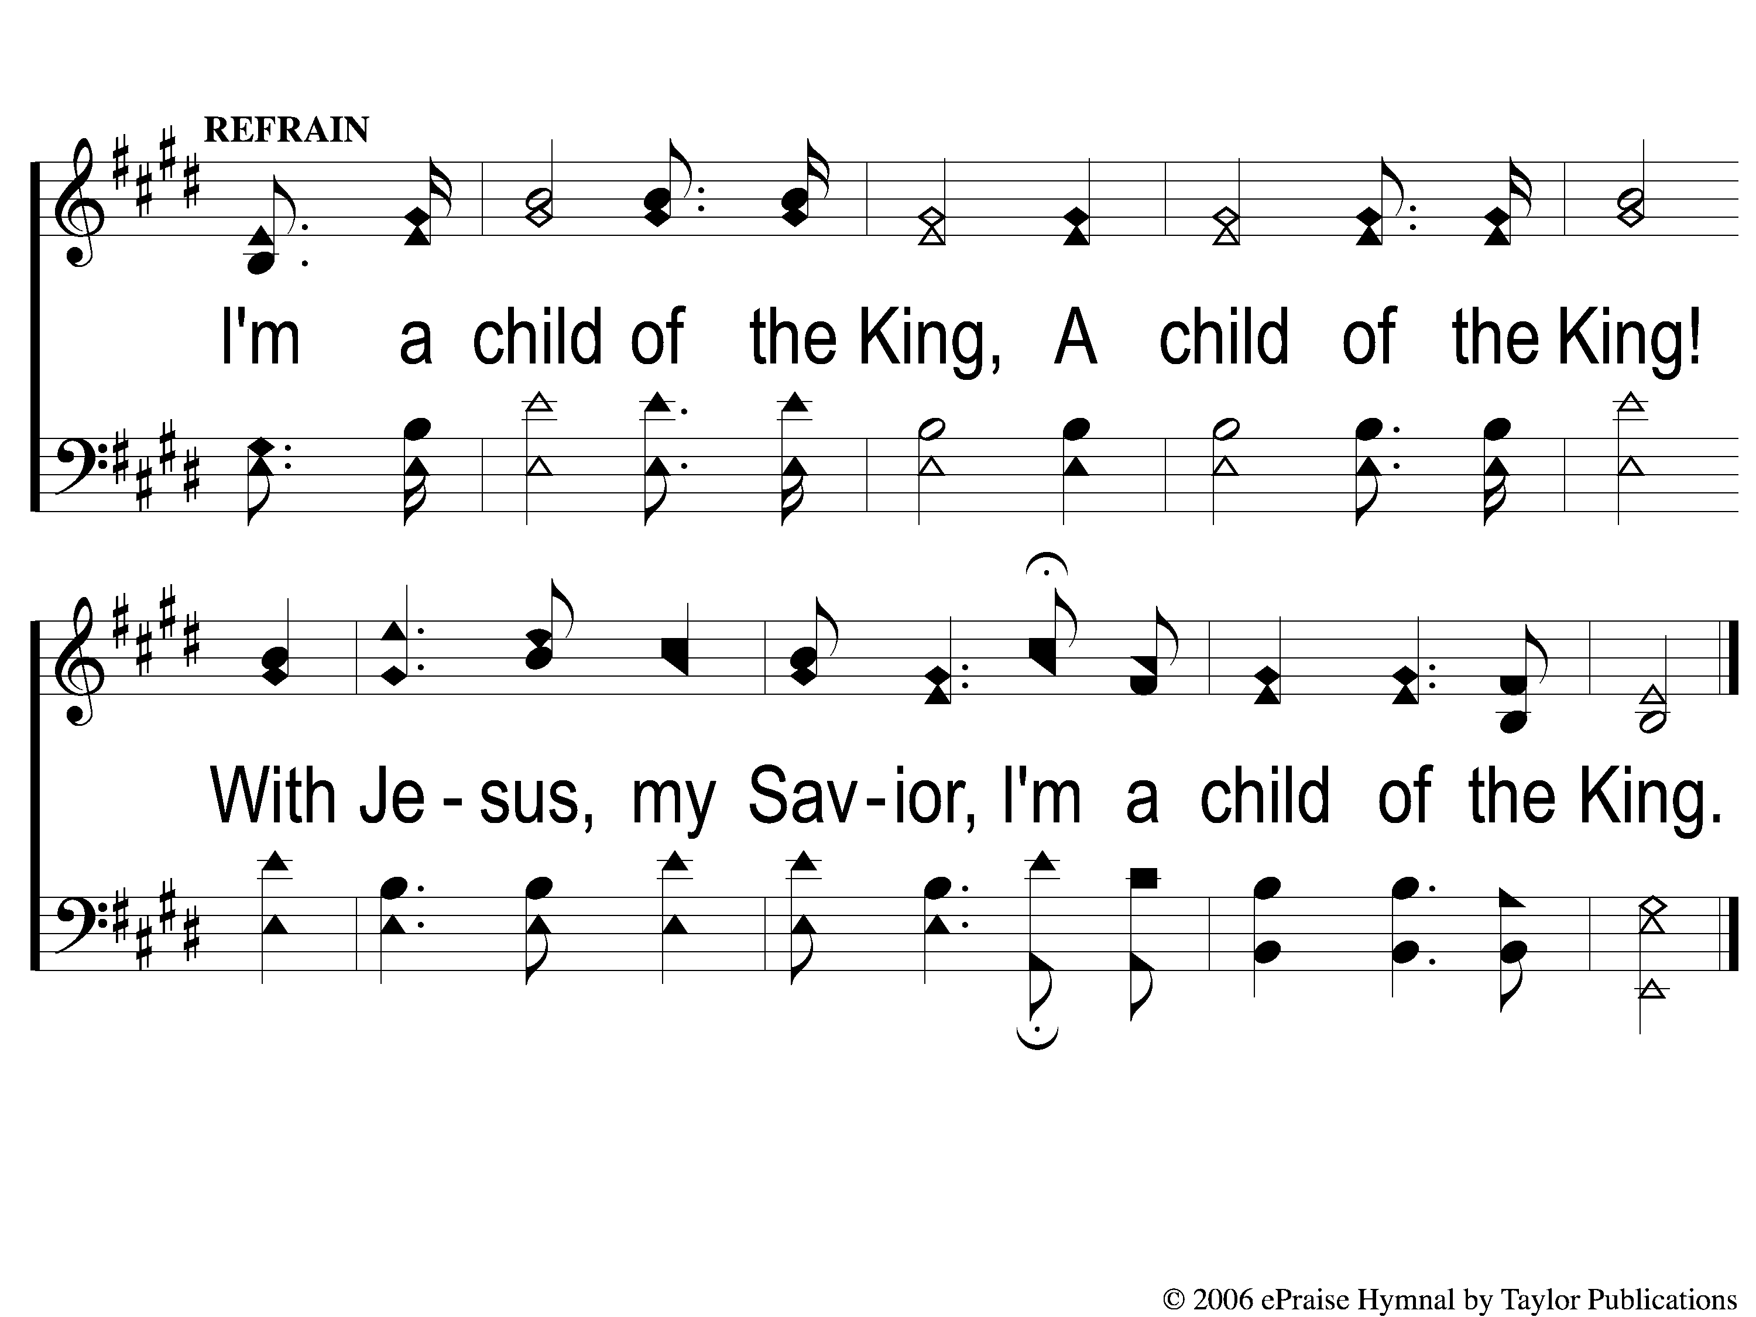
C-1 Child of the King
Child of the King
63

Slide 4
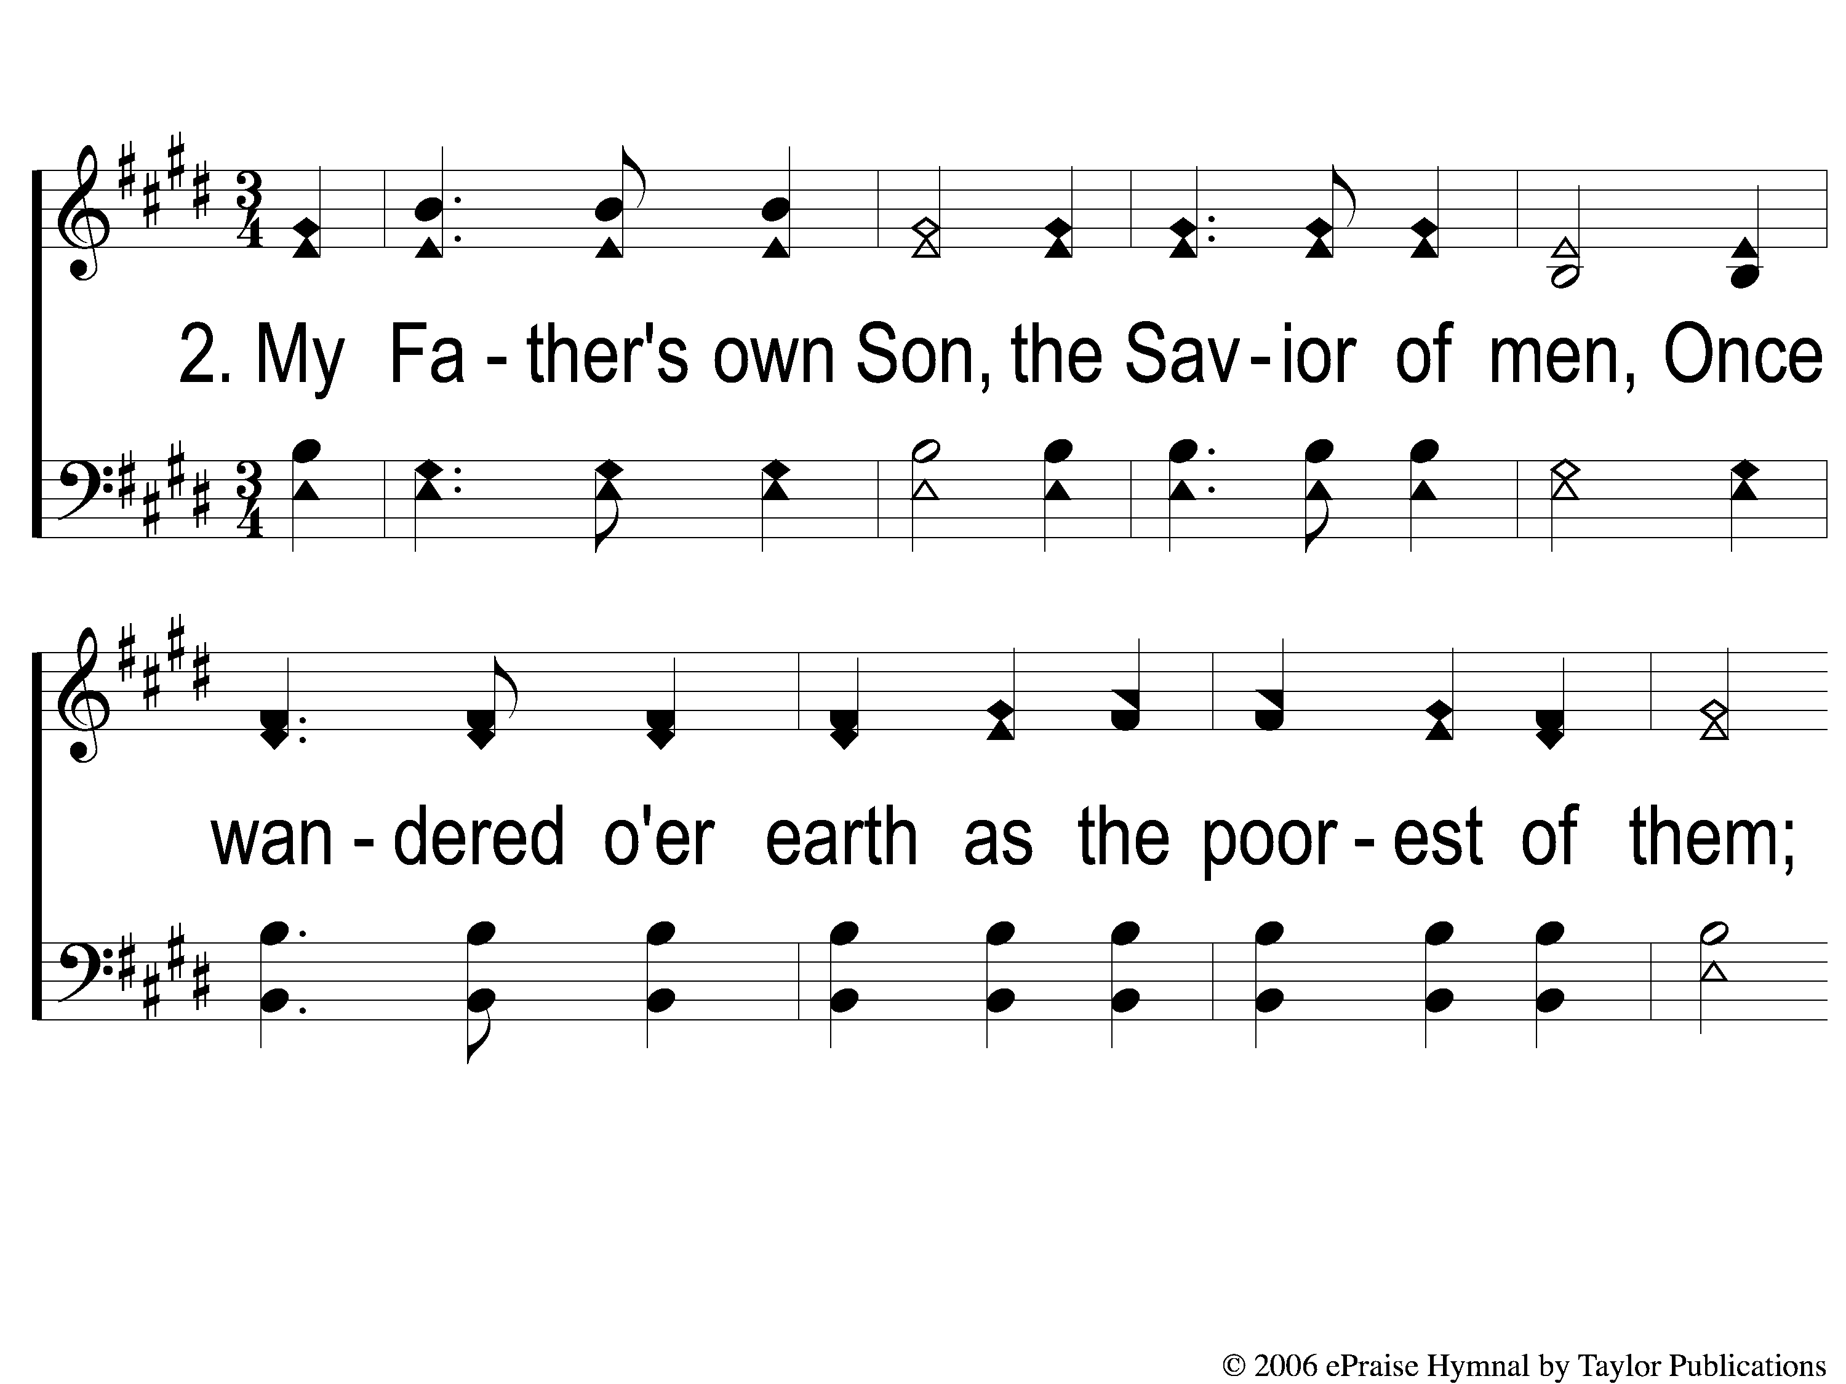
2-1 Child of the King
Child of the King
63

Slide 5
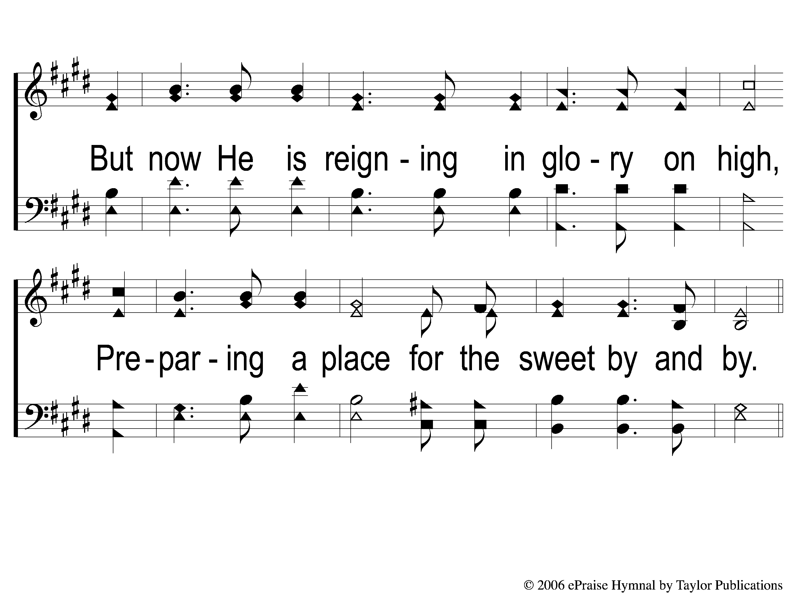
2-2 Child of the King
Child of the King
63

Slide 6
C-1 Child of the King
Child of the King
63

Slide 7
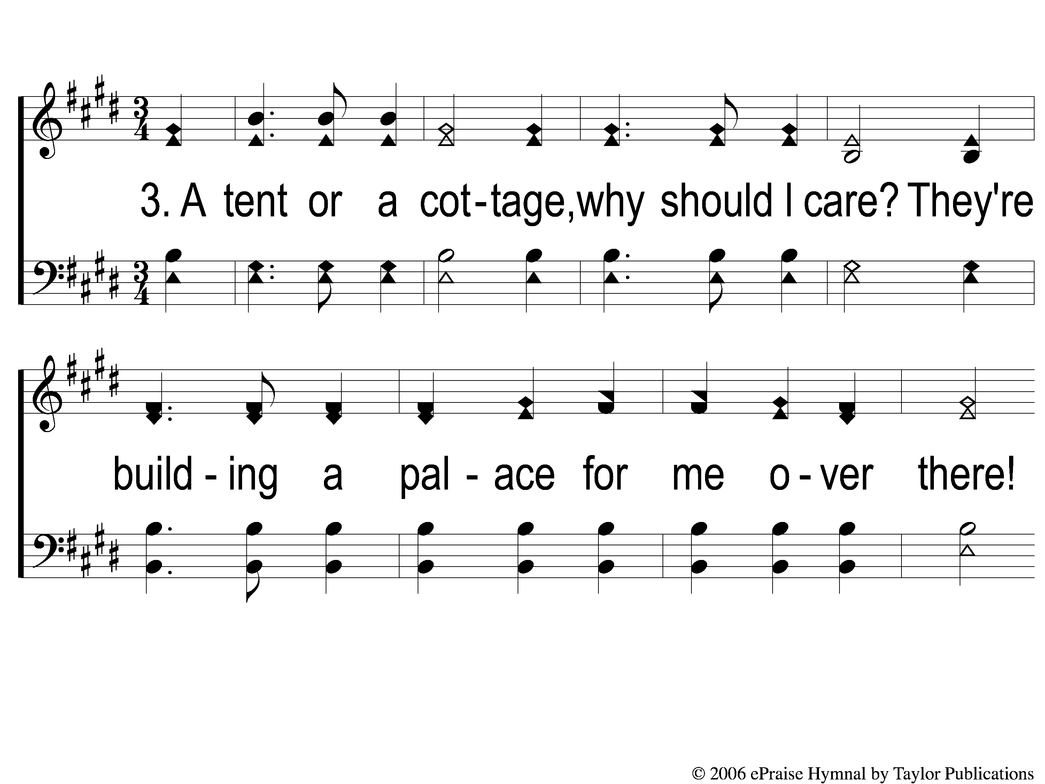
3-1 Child of the King
Child of the King
63

Slide 8
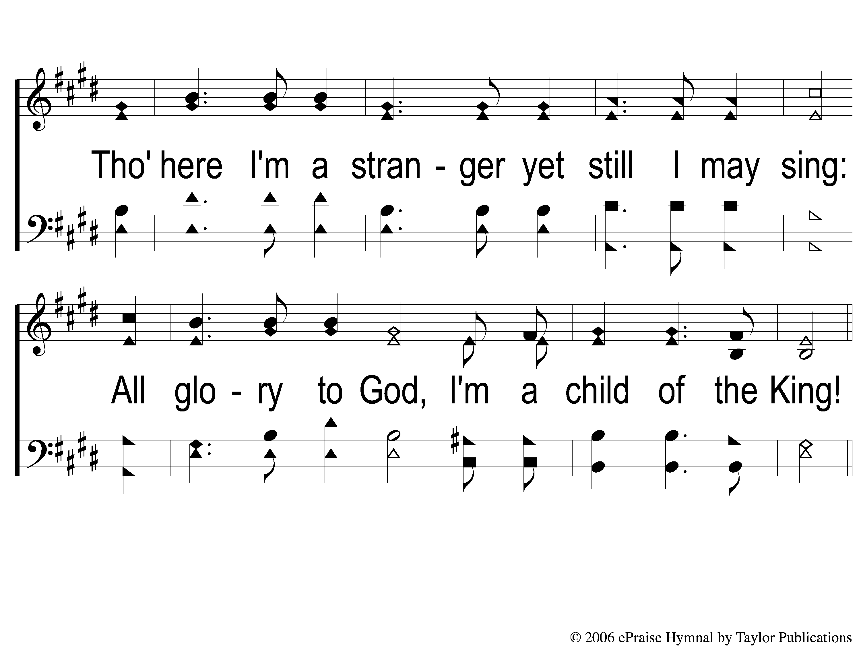
3-2 Child of the King
Child of the King
63

Slide 9
C-1 Child of the King
Child of the King
63

